Slide 1





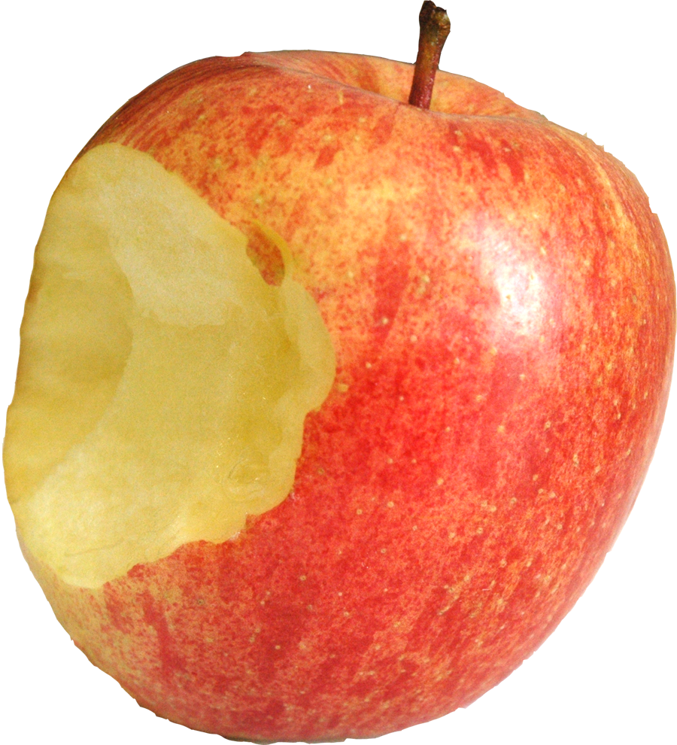

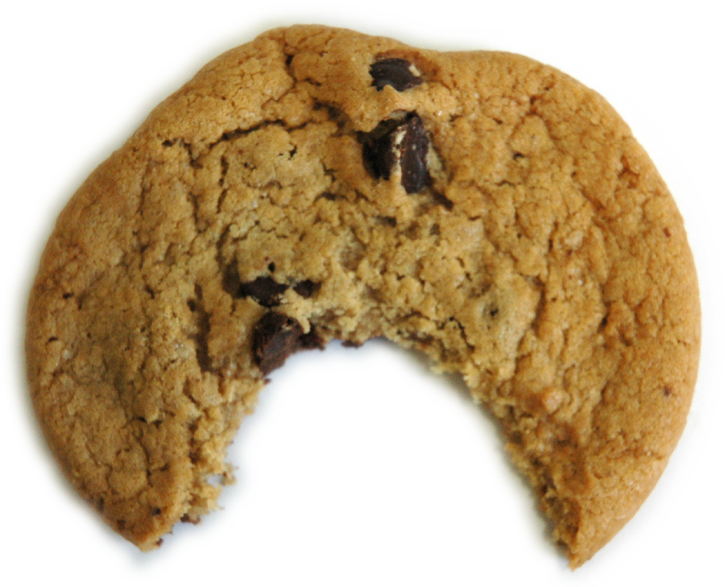
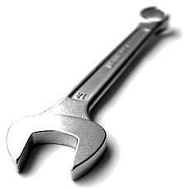















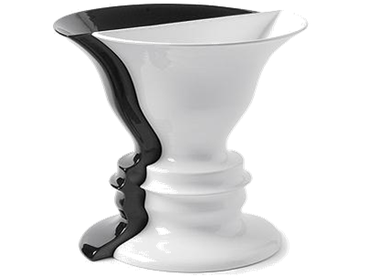
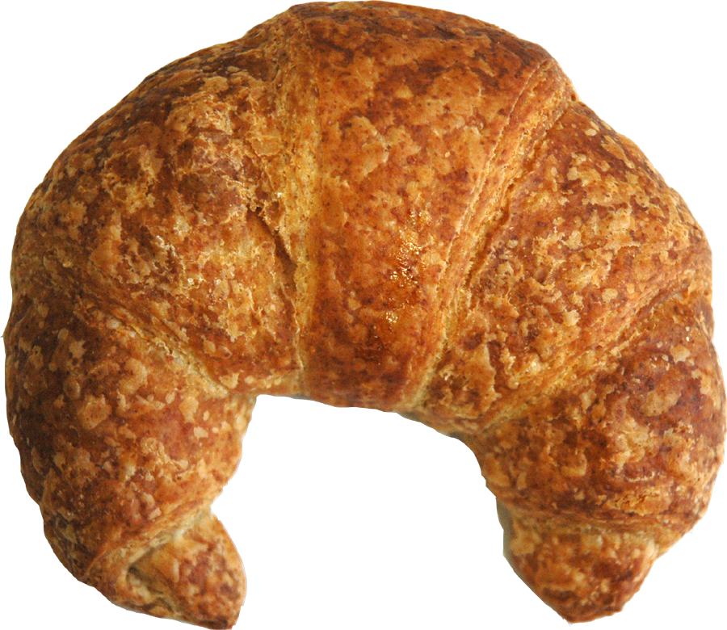



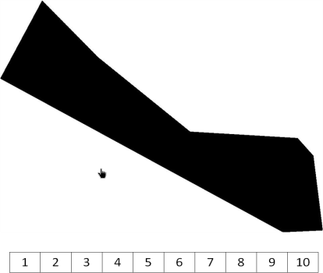
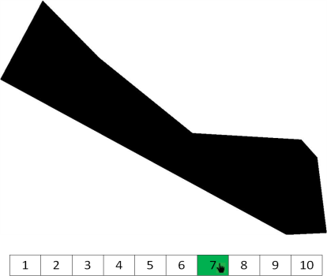
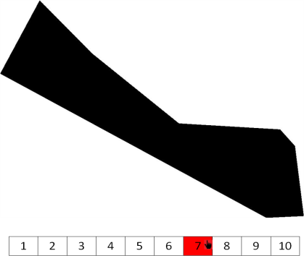
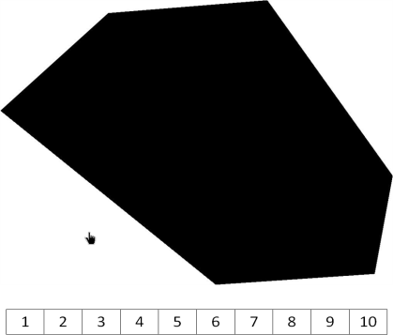
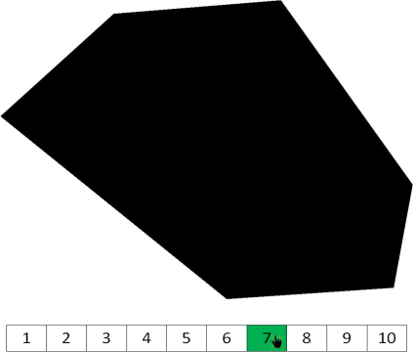
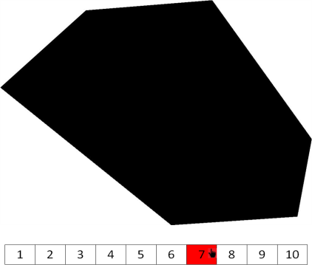
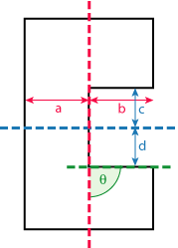
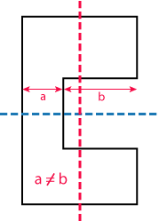
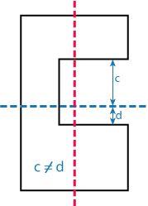
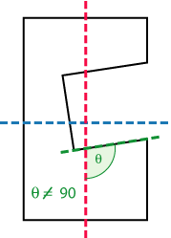


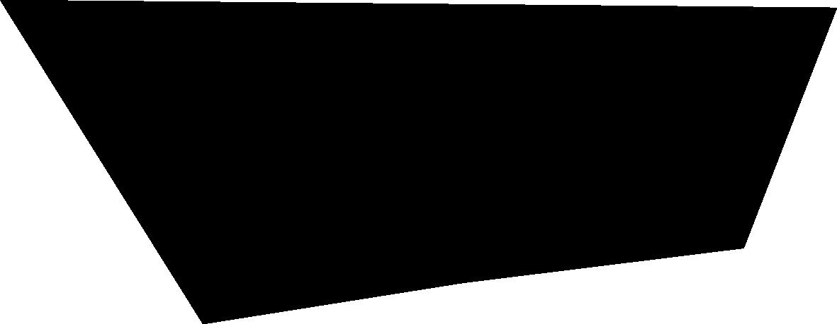


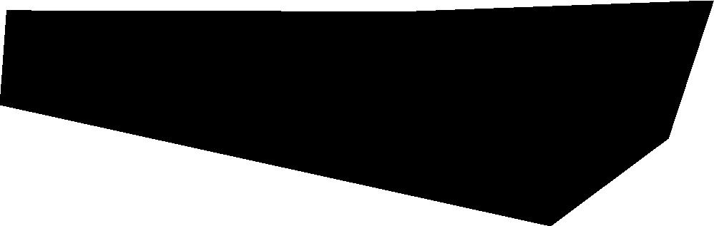

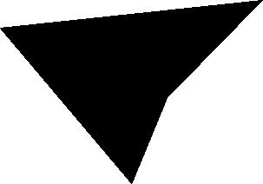
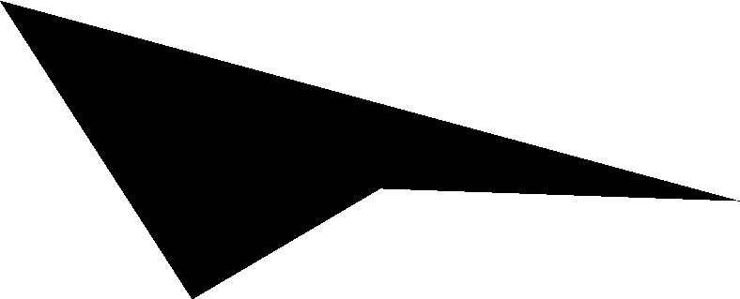




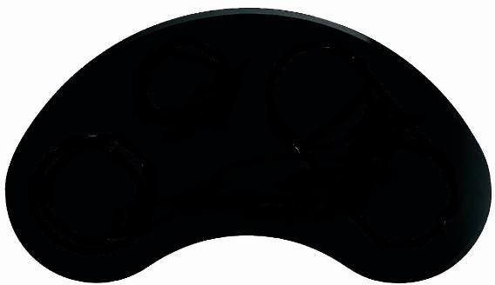

















"To bite, or not to bite“: Perceived causality in the perception of negative parts
Patrick Spröte & Roland W. Fleming | Justus-Liebig Universität Gießen
Background
Stimulus statistics
The more angles, the more ‘bitten‘
The more concave, the more ‘bitten‘
The larger the missing portion, the more ‘bitten‘
Discussion
α
β
Average rating as a function of the mean of the interior angles
Average rating as a function of the logarithm of relative depth
Average rating as a function of the logarithm of relative area
bitten
R²=.90
bitten
R²=.76
bitten
R²=.63
Our data suggest that subjects are good at inferring the causal history of unfamiliar ‘bitten’ 2D shapes.
On a between subject basis the relative depth of a negative part & and its relative area are good predictor of the subjects’ judgements.
Decomposition
Negative Parts
Relative area
Mean of interior angles
Width of
aperture
Relative depth
Rating
Rating
Rating
Task
whole
whole
whole
Mean of the interior angles
log relative depth
log relative area
Genericity
60°
90°
108°
135°
152°
-5.31
-3.67
-2.51
-0.95
0.72
-5.6
-3.74
-2.73
-1.64
-0.54
We presented different shapes in different sizes and orientations. Subjects indicated with a cursor on a 10-point scale the extent to which each object appeared to them to be ‘bitten‘.
Results (Experiment 2)
Stimuli: “Hexagon world”
The investigated shape properties in Experiment 1 were highly inter-correlated. Therefore we conducted a second Experiment with a set of stimuli for which, by design, the correlation between “mean of interior angles” & “relative depth” was kept near zero.
Mean of interior angles loses predictive power when uncorrelated with relative depth
Decreasing Symmetry
R² (mean interior angles) as a function of R² (log relative depth)
Stimuli were created from convex, irregular hexagons. From half of the stimuli, a portion of the shape was deleted by random intersection with another hexagon and removing the region of overlap.
Time
R² (mean of the interior angles)
Results (Experiment 1)
Relation to figure/ground
Interior angles are no longer
predictive
Negative parts‘ concavity predicts ‘bites‘
R² (log relative depth)
Whole
Subjects can do the task
Subjects are confident
Differences in judgements
Average rating as a function of the mean of the interior angles
Average rating as a function of the logarithm of relative depth
Average rating as a function of the logarithm of relative area
Proportion correct answers across subjects
Relative frequency categories were used
Interindividual differences in
judging ‘bitten‘ vs. ‘whole‘ shapes
bitten
R²=.10
bitten
R²=.59
R²=.33
counting vertices
concave = bitten
mean
Rating
Rating
Relatability
Proportion correct answers
Relative frequency
Proportion correct answers (whole shapes)
whole
whole
Bitten
Mean of the interior angles
log relative depth
log relative area
Subject ID
whole
Rating
bitten
Proportion correct answers (bitten shapes)
90°
108°
120°
129°
135°
140°
-5.22
-3.88
-2.6
-1.77
-0.42
-8.76
-5.75
-3.4
-1.2
-0.64
patrick.sproete@googlemail.com

